Slide 1
Hidden Markov Models and POS Tagging
Natural Language Processing
Individual Assignment
Arnav Mallick
M2022BSASS005

Slide 2
Outline of presentation
Motivation: Why POS tagging is necessary
Part-of-Speech (POS) tagging: task and challenges
Hidden Markov Models (HMMs) for POS tagging
Viterbi algorithm for best tag sequence
Training with the Brown corpus
Code walkthrough and demo
Evaluation and limitations
Notes:
We'll start with motivation—why POS tagging matters—then move through the theoretical foundations of HMMs and Viterbi, train models on the Brown corpus, and finally evaluate what works and what doesn't when data is limited

Slide 3
English can be confusing
Imagine this scenario:
  Two students, James and John, are asked by their English teacher to describe a man who had suffered from a cold in the past.
  John writes: “The man had a cold.” – marked incorrect.
  James writes: “The man had had a cold.” – marked correct.
  James’s answer, being more grammatical, creates a better impression on the teacher.
Question:
How would you describe this entire situation in one sentence?

Slide 4
Extreme but Grammatical Ambiguity
James while John had had had had had had had had had had had a better effect on the teacher
James, while John had had "had", had had "had had"; "had had" had had a better effect on the teacher.
Such an extreme, but grammatically correct, example of ambiguity and importance of punctuation that there’s a whole Wikipedia page dedicated to the sentence!
https://en.wikipedia.org/wiki/James_while_John_had_had_had_had_had_had_had_had_had_had_had_a_better_effect_on_the_teacher
Notes:
The difference in meaning comes entirely from which "had" is auxiliary versus main verb. Even punctuation depends on POS: commas appear based on grammatical structure, not just pauses. This shows that a whole Wikipedia page exists just to document ambiguity and the critical role of proper tagging

Slide 5
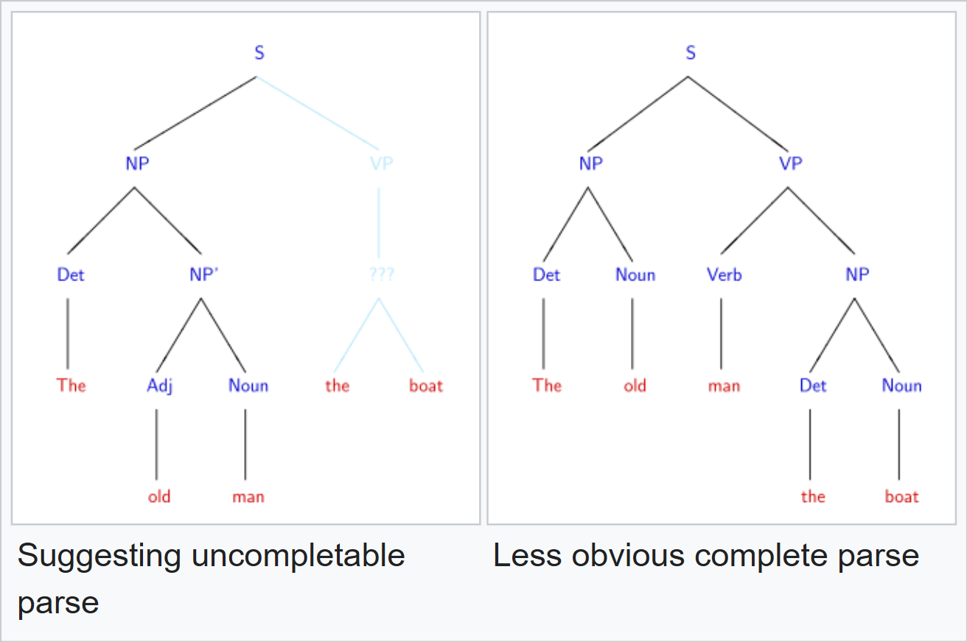
The Problem: Syntactic & Semantic Ambiguity
English is structurally and semantically ambiguous.
Garden-path sentences:
  “Time flies like an arrow; fruit flies like a banana.”
Structural ambiguity:
  “The old man the boat.”
Many sentences look wrong at first glance but are grammatically correct once we know the roles of the words.
Source: https://en.wikipedia.org/wiki/Garden-path_sentence
Notes:
English is structurally and semantically ambiguous. Words like "flies" can be a noun or verb, "bank" can mean a financial institution or a riverbank, and sentences like "Time flies like an arrow; fruit flies like a banana" show how context determines meaning. Every word in context needs a role assigned to parse meaning correctly, which is the sequence labeling problem we're solving.

Slide 6
What is Parts-of-Speech (POS) Tagging
Definition: Assign a grammatical tag (noun, verb, adjective, preposition, etc.) to every word in a sentence based on context and linguistic rules.
Tags: noun (NN), verb (VB/VBD/VBZ), adjective (JJ), adverb (RB), preposition (IN), determiner (DT), etc.
Example:
  Sentence: “The dog ran quickly in the park.”
  Tags: (The/DT) (dog/NN) (ran/VBD) (quickly/RB) (in/IN) (the/DT) (park/NN)
POS tagging is a sequence labelling problem:
  The tag of each word depends on the tags of neighbouring words.
Notes:
POS tagging assigns a grammatical tag—noun, verb, adjective, etc.—to every word in a sentence based on context and linguistic rules. For example, "The dog ran quickly in the park" becomes "The/DET dog/NOUN ran/VERB quickly/ADV in/ADP the/DET park/NOUN". This is a sequence labeling problem: the tag of each word depends on the tags of neighboring words. Tagging is foundational for parsing, named entity recognition, machine translation, and many other NLP tasks.

Slide 7
Why is POS Tagging Non-Trivial?
Many words belong to multiple parts of speech:
  “work” – noun or verb
  “book” – noun or verb
  “like” – verb, preposition, or conjunction
Pure dictionary lookup chooses only the most frequent tag => often wrong in context.
Correct tag depends on context:
  “I work every day.” → work = verb
  “This is my work.” → work = noun
We need a model that uses:
  The word itself (emission information), and
  The surrounding tags (transition information).
Notes:
Many words belong to multiple parts of speech. "Book" can be a noun ("the book") or a verb ("to book a flight"). "Work" is both a noun and a verb. Pure dictionary lookup chooses only the most frequent tag, often getting context wrong. For example, "I used every day" versus "I used everyday items"—"everyday" is an adjective in the second but "every day" is adverb + noun in the first. A model that uses context and sequence information is needed, and that's exactly what HMMs provide.

Slide 8

Hidden Markov Models
Hidden states: POS tags (NN, VB, JJ, …).
Observations: Words in the sentence.
Transition probabilities:
  $P\left(t_{i}∣t_{i−1}\right)$ – likelihood of tag $t_{i}$ following tag $t_{i−1}$.
Emission probabilities:
  $P\left(w_{i}∣t_{i}\right)$ – likelihood of word $w_{i}$ being generated by tag $t_{i}$.
Initial probabilities:
  $P\left(t_{1}\right)$ – likelihood of starting a sentence with tag $t_{1}$.
Goal: For a sentence $w_{1},...,w_{n}$, find the tag sequence $t_{1},...,t_{n}$ that is most probable under this model.
Notes:
An HMM treats POS tags as hidden states and words as observations. It models two things: transition probabilities—how likely one tag follows another—and emission probabilities—how likely a word is generated by a tag. Initial probabilities capture the likelihood of starting a sentence with a given tag. The goal: for a sentence with words w ₁ to w ₙ , find the tag sequence t ₁ to t ₙ that maximizes the probability P(tags | words), which decomposes into the product of transitions and emissions across the sequence

Slide 9

Tagging Problem as Optimization
Given words $W=w_{1},w_{2},...,w_{n}$, we want tags $T=t_{1},t_{2},...,t_{n}$ that maximize
$$P\left(T∣W\right)=\frac{P\left(W∣T\right)⋅P\left(T\right)}{P\left(W\right)}$$
  Since $P\left(W\right)$ is constant across all possible sequences, we maximize:$P\left(W∣T\right)⋅P\left(T\right)$
Using HMM structure:
$P\left(W∣T\right)⋅P\left(T\right)=\prod_{i=1}^{n}{P}\left(w_{i}∣t_{i}\right)⋅\prod_{i=1}^{n}{P}\left(t_{i}∣t_{i−1}\right)$
  First product: emission probabilities.
  Second product: transition probabilities.
Naive approach: Try all possible tag sequences. Problem – for $n$ words and $k$ possible tags, there are $k^{n}$ sequences => Computationally impractical.
Better approach: Use dynamic programming (Viterbi algorithm) to find the best sequence time.
Notes:
Given words W equals w ₁ through w ₙ , we want the tag sequence T that maximizes PT | W. By Bayes' rule, this is proportional to PW | T) times PT) over PW. Since PW) is constant across all tag sequences, we maximize PW | T) times PT. PW | T) is the product of emission probabilities P(wᵢ | tᵢ). PT) is the product of transition probabilities P(tᵢ | tᵢ ₋₁ ). The naive approach—try all possible tag sequences—is exponential and intractable. Viterbi solves this in polynomial time using dynamic programming. Key term: DP Dynamic Programming, a technique that breaks a problem into overlapping subproblems and stores solutions to reuse them instead of recomputing.]

Slide 10

Viterbi Algorithm Intuition
Build a table with:
  Rows = positions $1,2,...,n$ in the sentence.
  Columns = possible POS tags.
Each cell stores the highest probability of any path that:
  Ends at that word position, and
  Uses that tag at that position.
Recursion idea:
  For each word position $i$ and tag $t_{i}$:
    Look at all previous tags $t_{i−1}$.
    Score = [best score for $t_{i−1}$]] × $P\left(t_{i}∣t_{i−1}\right)$ × $P\left(w_{i}∣t_{i}\right)$].
    Keep the maximum over previous tags.
After filling the table, backtrack from the best-scoring tag in the last column to recover the tag sequence.
Notes:
Viterbi builds a table with rows as positions in the sentence and columns as possible tags. For each word position and tag, we compute the best score: emission probability times the maximum over all previous tags of (previous best score times transition probability). Each cell stores the best score and a backpointer to the best previous tag. After filling the table, we start at the last position with the highest score, follow backpointers backward, and reconstruct the optimal tag sequence. Time complexity is O(n × V_tags²), which is efficient even for long sentences. Key term: backpointer = a saved reference to the best previous tag at each step, used to reconstruct the path later.

Slide 11
Resolving ambiguity using Viterbi
Words like “man” or “flies” can be noun or verb.
Example: “The old man the boat.”
  “man” as verb (“to staff/operate”) is less frequent overall.
  But the context Det → Adj → Verb → Det → Noun forms a plausible pattern.
Viterbi combines:
  Emission probabilities: P(“man” | noun) vs P(“man” | verb).
  Transition probabilities: P(verb | adjective), P(det | verb), etc.
The best tag sequence is the one where the whole path has highest probability, not just each word individually.
Notes:
Take "The old man the boat." Without context, "man" looks like a noun. But "The old" DET ADJ) is often followed by a noun, and if "man" is tagged VERB, then "the boat" becomes the object. Viterbi picks DETADJVERBDETNOUN as the most probable path because transitions like ADJ-to-VERB and VERB-to-DET have higher joint probability. The best tag sequence is the one where the entire path has the highest probability, not just each word individually.

Slide 12

Training an HMM Tagger: Brown Corpus
Brown corpus:
  One of the earliest large, hand-tagged corpora of English.
  ~1 million words, multiple genres, each token labelled with a POS tag.
Training the HMM:
  From tagged sentences, estimate:
    Transition probabilities $P\left(t_{i}∣t_{i−1}\right)$ from tag bigram counts.
    Emission probabilities $P\left(w∣t\right)$ from word–tag counts.
  Apply smoothing so unseen events get small non-zero probability.
Train–test split:
  Use a portion of Brown for training and a held-out portion for testing.
Notes:
We train on the Brown Corpus: one of the earliest large hand-tagged English corpora, with over 1 million words, multiple genres, and each word already tagged. We use the universal tagset with 12 coarse tags: NOUN, VERB, DET, ADJ, etc., instead of 50+ fine-grained tags, to reduce sparsity. The corpus is split 9010 into training and test. From tagged sentences, we estimate transition probabilities P(tagᵢ | tagᵢ ₋₁ ) and emission probabilities P(word | tag). A special START symbol marks sentence beginnings. V_tags equals 12; V_words is around 53,690 unique words. Key term: V_tags = vocabulary size of tags 12; V_words = vocabulary size of unique words 53,690.]

Slide 13

Evaluating the tagger
We use the test set to measure accuracy:
$$Accuracy= \frac{\#correctly tagged words}{\#total words in test set}$$
Compare to simple baselines:
  Always assign the most frequent tag (e.g., NN).
  Unigram tagger: most common tag for each word.
HMM / bigram tagger usually improves accuracy by using context.
Qualitative evaluation:
  Inspect sentences where the tagger makes mistakes.
  Common confusion between word forms can be resolved (as we will see later)
Notes:
We measure accuracy as the fraction of correctly tagged words on the test set. Compare to simple baselines: always assign the most frequent tag ignoring context, or use a unigram or bigram model. HMM with bigram transitions should theoretically improve accuracy by using context. Quantitative evaluation shows where the model succeeds and where sparsity becomes a problem. Common confusion: mistagging rare words or distinguishing noun versus verb in ambiguous contexts

Slide 14
Zero Probability Problem in Language Models
Problem - Maximum Likelihood Estimation (MLE) assigns 0 probability to unseen events
  If bigram "W₁ → W₂" never appears in training, P(W₂ | W₁) = 0/count = 0
  Any sentence containing an unseen bigram gets P(sentence) = 0
Why is zero probability bad?
  Multiplying probabilities: P(sentence) = P(w₁) × P(w₂|w₁) × ... × P(w_{n}|w_{n-1})
  One zero kills the entire product
  Viterbi algorithm breaks: can't build valid tag sequences
Example from our data:
  Training: "I like mathematics“
  Test: "I like coding"
  If "like → coding" never seen in training → probability = 0
  Model says the sentence isn’t possible even though it's perfectly fine.
Why does this happen? Language has infinite combinations; training data is finite – for instance, even with ~1M words (Brown corpus), most word/tag pairs are rare or absent.
This leads to something called Data Sparsity Problem.
Notes:
Maximum Likelihood Estimation, or MLE, estimates probabilities as count(event) divided by count(context). For transitions, that's count(tagᵢ ₋₁ , tagᵢ) divided by count(tagᵢ ₋₁ ). For emissions, count(tag, word) divided by count(tag). The problem: many (tag, tag) bigrams and (tag, word) pairs are never seen in training, so their counts are zero. This leads to probability zero. In a generative sequence model, if even one transition or emission is zero, the entire path probability becomes zero, and Viterbi can't distinguish between paths. This is called the "data sparsity problem"—it leads to model collapse when unseen events dominate. Key term: MLE Maximum Likelihood Estimation; count-based probability without smoothing.]

Slide 15

Laplace (Add-1) Smoothing: The Solution
Core Idea: Add 1 to every possible n-gram count → Prevents zero probabilities for unseen word pairs
Probability Formulation
  MLE (No Smoothing):$P\left(w∣t\right)=\frac{\text{count}\left(w , t\right)}{\text{count}\left(t\right)}$
  Laplace Smoothing:$P\left(w∣t\right)=\frac{\text{count}\left(w , t\right)+1}{\text{count}\left(t\right)+V}$
  where $V$= vocabulary size (unique words)
Why It Works:
  Unseen pairs get non-zero probability
  Seen pairs lose a small amount of probability mass
  Denominator adjustment keeps probabilities normalized
Bigram Formula
  $$P_{\text{Laplace}}\left(w_{n}∣w_{n−1}\right)=\frac{\text{count}\left(w_{n−1} , w_{n}\right)+1}{\text{count}\left(w_{n−1}\right)+V}$$
Example
Training Data:
  I like coding
  Prakriti likes mathematics
  She likes coding
Test Sentence:
  I like mathematics
Without Smoothing: P(like → mathematics) = 0
With Laplace Smoothing:
P(like → mathematics) = (0 + 1) / (3 + 9) = 1/12 ≈ 0.083 (still very small, but non-zero)
Trade-offs
  Eliminates zero-probability issue
  Slightly underestimates probabilities of frequent events
  Improves performance on unseen data
Notes:
Laplace smoothing fixes this by pretending we saw every event at least once. For transitions: P_Laplace(tagᵢ | tagᵢ ₋₁ ) equals (count + 1) divided by (total_count + V_tags). For emissions: P_Laplace(word | tag) equals (count + 1) divided by (total_count + V_words). This adds 1 to the numerator and adds the vocabulary size to the denominator to keep probabilities normalized. Why it works: common events with large counts barely change—0.9940 becomes 0.9833. Rare or unseen events go from zero to a small non-zero value like 0.001. Trade-off: we steal a bit of probability mass from frequent events to give to unseen ones, but this prevents path collapse in Viterbi. Key terms: Laplace smoothing = add-1 smoothing; V_tags and V_words are vocabulary sizes added to denominators.]

Slide 16
Limitations of HMM Tagging and Modern Approaches
Markov assumption: only previous tag (or previous 2 tags) influence the current tag.
  Long-range dependencies are ignored.
Emission independence: word depends only on its tag, not on neighboring words.
Fixed tagset and vocabulary: struggles with unknown words.
Modern sequence models:
  Conditional Random Fields (CRFs) – richer features, relax independence assumptions.
  Recurrent neural networks (RNNs) and transformers (BERT) – capture longer context.
HMMs are still useful for:
  Teaching and understanding sequence modeling and dynamic programming.
  Small data settings where large neural models are overkill.
Notes:
HMM has strong assumptions: Markov assumption means only the previous tag matters, ignoring longer context; emission independence means a word depends only on its tag, not neighboring words. Laplace smoothing is naive—it treats all unseen events equally, even though some are linguistically plausible and others aren't. Fixed bigram context is rigid and doesn't capture long-distance dependencies. Modern approaches use Conditional Random Fields CRFs with richer features, Recurrent Neural Networks RNNs with memory across sequences, and Transformers like BERT with bidirectional context and pre-training on billions of words. Teaching HMM and Viterbi is important because DP and sequence decoding underpin all these modern models. Key terms: CRF Conditional Random Field; RNN Recurrent Neural Network; BERT Bidirectional Encoder Representations from Transformers.]

Slide 17
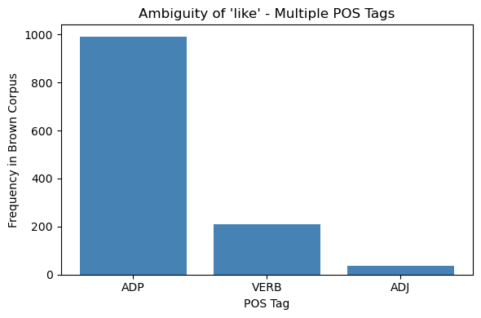
Code Demo
We will look at four models –
Unigram Tagger: Most frequent tag per word; no context
2. Bigram Tagger (with backoff): Previous tag predicts current; backs off to unigram when sparse
3. HMM Tagger: Full generative sequence model; uses Viterbi to find best path
4. Treebank (Pre-trained baseline): Trained on Penn Treebank; external reference point
PROBLEM: Words have multiple meanings.​
57K sentences, 1.16M words, 12 POS tags in Brown (universal).​
Examples of ambiguity:
  "like" → ADP, VERB, ADJ (highly skewed but clearly multi-tag).​
Model | Complexity | Context | Training Data
Unigram | Low | None | Brown only
Bigram | Low | Yes (1 step) | Brown only
HMM | High | Yes (full) | Brown only
Treebank | Very High | Complex features | Penn Treebank
Key Questions:
How do different models resolve this ambiguity using context?
Does more model complexity → higher accuracy?
Notes:
Now let's see how this plays out in code. We'll walk through four models for comparison: Unigram Tagger: most frequent tag per word, no context. Bigram Tagger with backoff: uses previous tag when seen, falls back to unigram otherwise. HMM Tagger: full generative sequence model with transitions and emissions. Treebank Pre-trained baseline): trained on Penn Treebank, mapped to universal tags for comparison. Let's see how each performs on Brown and understand why complexity doesn't always mean better accuracy

Slide 18
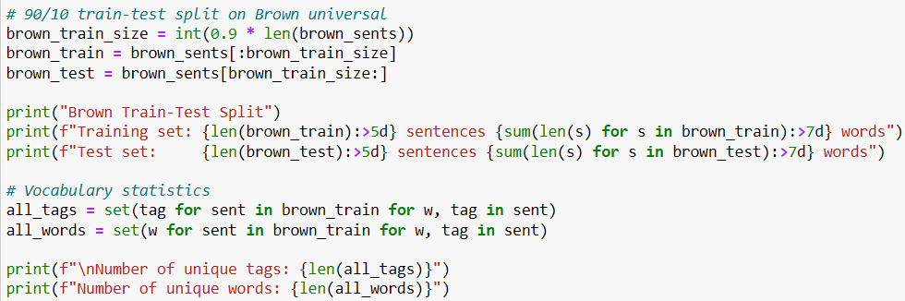
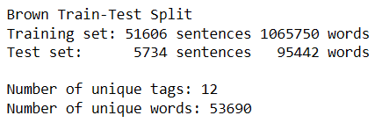
Preparing Brown Corpus data
brown.tagged_sents(tagset='universal') loads pre-tagged Brown corpus, converts fine-grained tags to 12 universal POS tags
train_size = int(0.9 * len(...)) splits 90% train, 10% test; ensures no data leakage
word_tag_freq is nested dict: for each word, count how many times it appears with each tag
Loop iterates every (word, tag) pair in training, increments the count
ambiguous = {w: tags for w, tags in ... if len(tags) > 1} filters only words with multiple possible tags
Notes:
"First, we load the Brown corpus with pre-tagged sentences and convert all fine-grained tags into 12 universal tags to simplify the problem. Why 12? Because collapsing tags like NN, NNS, NNP into just NOUN reduces sparsity and makes models easier to train on limited data. We split the data 9010: training gets 51,606 sentences to learn from, and we hold out 5,734 sentences for testing to measure generalization. After loading, we see 12 tags and 53,690 unique words. That's a large vocabulary, which will become a sparsity challenge later. For each word, we count how many times it appears with each tag. This reveals ambiguity: 'like' can be ADP, VERB, or ADJ depending on context. These frequency tables feed directly into our transition and emission count dictionaries for the HMM." Q&A Ready: Q What does tagset='universal' do? A It converts Brown's 50+ fine-grained tags NN, NNS, VBD, etc.) into 12 universal coarse tags NOUN, VERB, ADJ, etc.) to reduce sparsity. Q Why 9010 split specifically? A Standard practice—90% gives enough training examples, 10% is large enough to get reliable test accuracy without wasting data. Q What's defaultdict(lambda: defaultdict(int)) ? A Nested dictionary that automatically initializes missing keys to 0, so you can increment counts without checking if the key exists first. Non-intuitive variable: tuples.

Slide 19
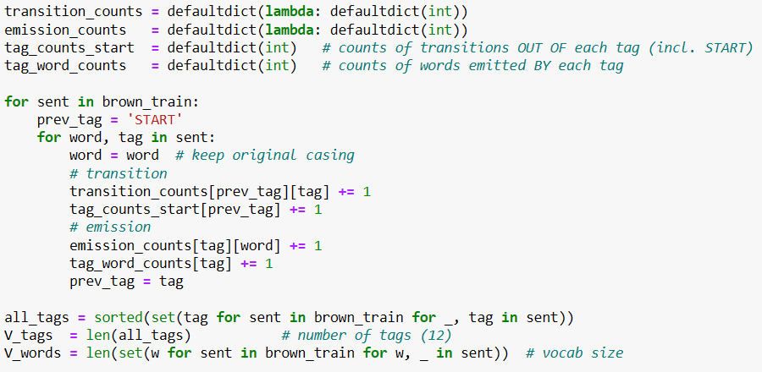

Laplace Smoothing Setup
transition_counts creates a nested dictionary where every unseen (prev_tag, tag) pair starts at count 0, so you can safely increment without KeyError.​
Inside the loop over brown_train, prev_tag = 'START' initializes a special start symbol before each sentence; for every (word, tag) we increment transition_counts and tag_counts_start, which together are the numerator and denominator for $P\left(t_{i}∣t_{i−1}\right)$.​
emission_counts and tag_word_counts play the same role for emissions: they store how many times each word appears with each tag, and the total number of words emitted by that tag.​
all_tags and V_tags compute the size of the tag vocabulary, while all_words and V_words do the same for words; these V_tags and V_words terms are exactly what go into the Laplace denominators (count + V).​
Notes:
"Now we build the count dictionaries. transition_counts is a nested dictionary: for each previous tag, it counts how often each next tag follows. We use a special START symbol to mark sentence beginnings, so we can estimate P(first_tag | START. emission_counts does the same for word generation: for each tag, count how many times it generates each word. We also track totals: tag, and tag_counts_start sums up all transitions from each tag_word_counts sums all words emitted by each tag. These totals become the denominators in our probability formulas. The vocabularies are V_tags equals 12—only 12 possible tags—and V_words equals 53,690, the entire word vocabulary. These V values are critical for Laplace smoothing, where they get added to denominators to reserve probability mass for unseen events." Q&A Ready: Q Why do we need tag_counts_start ? A It's the total count of all transitions from a given tag, used as the denominator when computing P(next_tag | prev_tag). Q What's the START symbol for? A HMMs need initial probabilities—P(first_tag | START to handle sentence beginnings. Without it, we'd have no way to score the first tag. Q Why is V_words so large? A Brown has 53K unique words but only 1M total tokens, so most words are rare. This sparsity will hurt emission probabilities later. Non-intuitive variables: tag_counts_start = denominator for transitions; denominator for emissions.

Slide 20
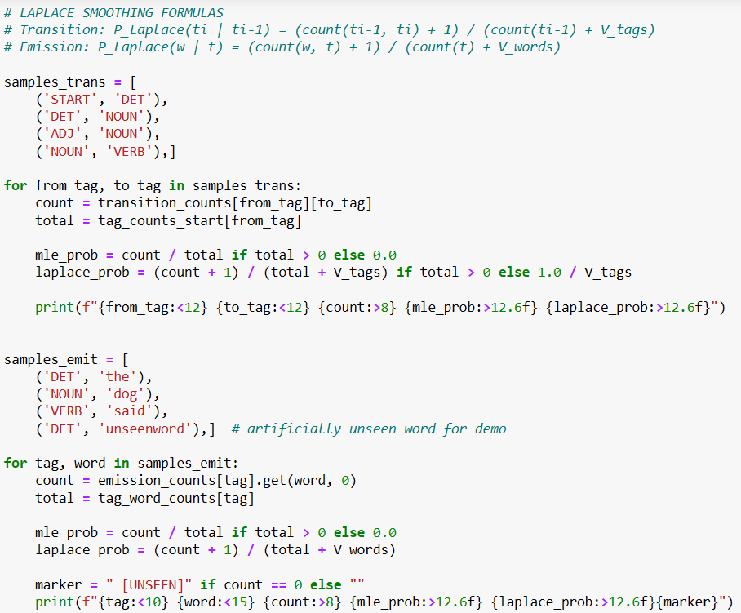
Transition and Emission within Laplace
Transition counts looks at how often prev_tag is followed by tag in training
  Example: how many times does DET precede NOUN?
  Initialize with 'START' symbol to mark sentence beginnings
Emission counts looks at how often tag generates that word
  Example: how many times does NOUN generate "dog"?
  Track total words per tag in tag_word_counts[tag] (for denominator)
Vocab sizes: V_tags = 12, V_words ≈ 50K
  Used in Laplace smoothing: unseen events get probability 1/V
These dictionaries are frequency tables, not probabilities yet; the next step is normalization + smoothing
Notes:
This code shows the Laplace smoothing formulas in action. For transitions, we take the count of (prev_tag, tag) and add 1, then divide by the total transitions from prev_tag plus V_tags. So even if a transition was never seen, it gets 0 1) divided by (total + 12, which is small but non-zero. For emissions, same logic: count of (tag, word) plus 1, divided by total words for that tag plus V_words. Because V_words is huge—53,690—even frequent words get smoothed downward significantly. For example, 'the' with DET has a raw count of 58,824, but after smoothing the probability drops because we're adding 53,690 to the denominator. The key insight: Laplace ensures no probability is ever exactly zero, but the trade-off is that it penalizes frequent events slightly and gives unseen events very tiny probabilities. For sparse data, this is essential to keep Viterbi paths from collapsing." Q&A Ready: Q Why does emission smoothing hurt more than transition smoothing? A Because V_words 53,690) is much larger than V_tags 12, so adding V_words to the denominator shrinks probabilities more drastically. Q What if a word never appears in training? A It's an OOV—out-of-vocabulary—word. Laplace gives it probability 0 1 / (tag_total + 53,690 ≈ 0.00002, tiny but not zero. Q Does Laplace treat all unseen events equally? A Yes, that's its weakness. Linguistically plausible unseen bigrams (e.g., DET → ADJ) get the same boost as impossible ones (e.g., DET → CONJ. Better smoothing methods like Kneser-Ney can distinguish these. Non-intuitive term: OOV Out-Of-Vocabulary word, never seen in training.] SLIDE 21 Smoothing Results 30 sec + Q&A ready) Script: "Here's the comparison table. For common transitions like START to DET or DET to NOUN, ML

Slide 21
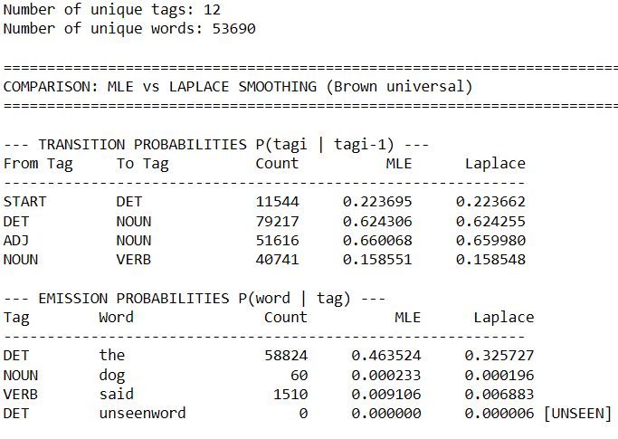
Smoothing Results
MLE (raw): P(tag | prev_tag) = count / total_count
  If count=0 (unseen) → probability = 0
  This breaks Viterbi
Laplace smoothing: P(tag | prev_tag) = (count + 1) / (total_count + V_tags)
  Add 1 to numerator (pretend we saw it once)
  Add V_tags to denominator (account for all possible tags)
  Unseen gets tiny but non-zero: 1 / (total + V_tags)
Emission same logic: P(word | tag) = (count + 1) / (tag_total + V_words)
  V_words is huge → smoothed emission is very small for unseen words (OOV)
Trade-off: Frequent events lose a bit of mass → unseen events get rescued
Notes:
"Here's the comparison table. For common transitions like START to DET or DET to NOUN, MLE and Laplace are nearly identical—0.223695 versus 0.223662, barely any difference because counts are large. But for unseen transitions, MLE gives exactly 0.000000, which kills paths in Viterbi. Laplace rescues them: 0.000000 becomes 0.000006—tiny, but non-zero. Same pattern for emissions. 'The' with DET is frequent, so smoothing barely changes it. But 'unseenword' with DET has count zero, so MLE gives zero and Laplace gives 0.000006. This tiny rescue is what keeps the HMM functional on test data with unseen words." Q&A Ready: Q Why is the Laplace probability for unseen words so small? A Because V_words is 53,690, so 1 / (total + 53,690 ≈ 0.00002. That's the cost of spreading probability mass over a huge vocabulary. Q Does this mean Laplace solves the sparsity problem? A No, it rescues zero probabilities, but doesn't solve sparsity. The probabilities are still tiny, and multiplying many tiny numbers in Viterbi can still cause numerical underflow or path collapse. Key insight: Frequent events barely change; unseen events jump from 0 to tiny non-zero.]

Slide 22
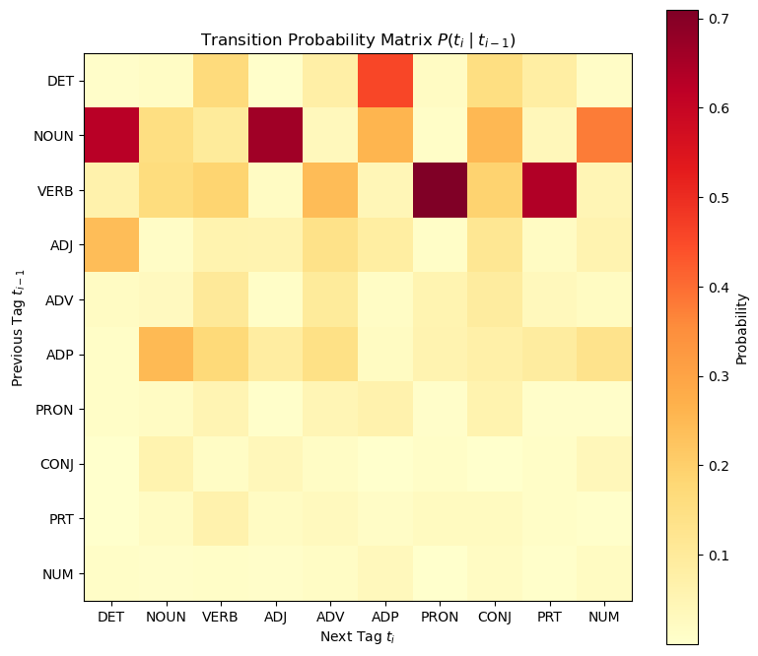
Transition Probability Matrix (visualized)
Dark red shows high-probability transitions (e.g., NOUN→DET, VERB→PRON)
Light yellow shows rare/unlikely transitions
This structure guides the Viterbi algorithm to prefer plausible tag sequences
Symmetry breaks because POS sequence patterns are directional (determiners precede nouns, not vice versa)
Notes:
"This heatmap shows the Laplace-smoothed transition matrix. Rows are 'from' tags, columns are 'to' tags. Bright red means high probability—for example, DET to NOUN is 0.624, very common. ADJ to NOUN is 0.660, also strong. Dark blue means rare: NOUN to NOUN is only 0.158 because nouns rarely repeat directly without a determiner or verb in between. Notice the matrix is not symmetric—DET often precedes NOUN, but NOUN rarely precedes DET. This asymmetry captures grammatical structure: determiners introduce noun phrases, so the arrow mostly goes one direction. Light yellow areas show smoothed-but-rare transitions that Laplace keeps non-zero." Q&A Ready: Q Why are some cells bright and others dark? A Syntax: certain tag sequences are grammatically common DET → NOUN, others are rare or impossible CONJ → CONJ. Q What's the diagonal represent? A Self-transitions NOUN → NOUN, VERB → VERB. These are rarer because most sentences alternate between tag types rather than repeating the same tag consecutively. Non-intuitive: matrix is asymmetric because language has directional structure—DET before NOUN, not vice versa.

Slide 23
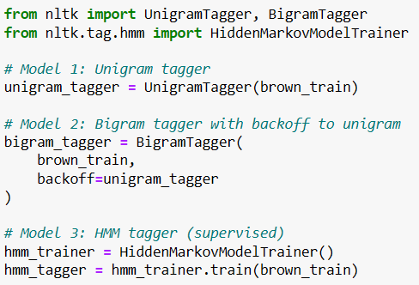

Models Comparison
Unigram tagger:
  learns $P\left(\text{tag}∣\text{word}\right)$.
  Uses only the current word.
  Simple and robust.
  Ignores sequence structure.
Bigram tagger with backoff:
  learns $P\left({\text{tag}}_{i}∣{\text{tag}}_{i−1}\right)$, but if the bigram is unseen it falls back to the unigram tagger.
  Uses context when it is reliable.
  Avoids zero probability by backing off.
HMM tagger:
  combines $P\left({\text{tag}}_{i}∣{\text{tag}}_{i−1}\right)$ and $P\left({\text{word}}_{i}∣{\text{tag}}_{i}\right)$.
  Full generative sequence model.
  Powerful but highly sensitive to sparse transitions and emissions.
Notes:
"Here we train four models. Unigram learns P(tag | word) only—fastest but ignores context. Bigram learns P(tag | prev_tag) and uses backoff=unigram_tagger , meaning if a bigram is unseen, it falls back to the unigram probability. This backoff is crucial for handling sparsity. HMM uses HiddenMarkovModelTrainer , which fits both transitions and emissions from the training data, then uses Viterbi for decoding. Finally, TreebankPOS is nltk.pos_tag , a pre-trained tagger from the Penn Treebank. We map its fine-grained tags to universal with 'universal', tag) so we can compare on the same 12-tag scale." Q&A Ready: Q What does backoff=unigram_tagger do? map_tag('en-ptb', A When the bigram tagger sees a (prev_tag, word) combination it never trained on, it delegates to the unigram tagger, which just picks the most frequent tag for that word. This prevents the bigram model from failing on unseen sequences. Q What is A 'e 'en-ptb' in map_tag ? n-ptb' stands for English Penn Treebank tagset. The pre-trained tagger uses PTB's 50+ tags NN, VBD, etc.), and map_tag converts them into universal coarse tags NOUN, VERB) so we can compare apples-to-apples against Brown-trained models. Q Why not just use the Treebank tagger for everything? A Because it's a black box trained on different data. The goal here is to understand HMM internals and see how sparse data affects performance, not just get the highest accuracy. Non-intuitive: 'en-ptb' = Penn Treebank English tagset identifier.

Slide 24
Why Unigram avoids the sparsity problem that hurts Bigram when using Brown
Unigram – robust to sparsity
Eg. – how to tag ‘dog’?
=Look how many times ‘dog’ was tagged as NOUN in training?
Eg – Training obs for ‘dog’ –
  NOUN = 450
  VERB = 2
  Total = 452
P(NOUN) = 450/452 = 99.6%
This works even if (DET | ‘dog’) are never seen together
HMM (MLE) fails to escape sparsity
Eg. – how to tag ‘dog’ after ‘the’
= Look for (DET → NOUN| ‘dog’) in training
Case 1: Common word pair
  Eg. (DET | NOUN, ‘dog’) 45 times
  P(NOUN | DET) x P(‘dog’|NOUN) = high
Case 2: Rare word pair
  Eg. (DET | NOUN, ‘zephyr’) = 0 times/unseen
  P(NOUN | DET) x P(‘zephyr’ | NOUN) = 0
Entire sentence probability collapses to 0
HMM multiplies many sparse probabilities → path scores collapse → Viterbi picks 'least bad' sequence (No Backoff)
Notes:
"Unigram is robust because it models P(tag | word) directly—no sequence, so no multiplication of sparse probabilities. For common words like 'the' or 'dog', the most frequent tag is almost always correct, which is why unigram gets 91.56% accuracy. Bigram adds context: P(tag | prev_tag). But with V_tags squared equals 144 possible bigrams and only about 20 observed in Brown, 88% are unseen. The key difference: bigram backoff rescues this. When a bigram is unseen, it doesn't assign zero—it falls back to the unigram P(tag | word), which is reliable. So bigram gets 92.46%—higher than unigram—because it uses context when safe and falls back when sparse. HMM, by contrast, has no fallback. It multiplies sparse transitions and sparse emissions across the whole sentence. Even with Laplace, many products are near-zero, and Viterbi struggles to find good paths. That's why HMM drops to 70.11% despite being theoretically richer." Q&A Ready: Q If HMM models more structure, why does it lose to bigram? A Because HMM is generative—it must model P(tags, words) jointly. Sparse data means many (tag, word) and (prev_tag, tag) pairs have tiny probabilities. Multiplying many tiny numbers collapses the path score. Bigram is discriminative—it only models P(tag | context) and uses backoff, avoiding the multiplication problem. Q What does '88% sparsity' mean? A Out of 144 possible tag bigrams 12 12, only about 20 are actually seen in training. So 124 / 144 ≈ 8688% are unseen, forcing Laplace to assign them very small probabilities. Key insight: Backoff saves bigram; HMM has no such fallback and suffers from path collapse.]

Slide 25
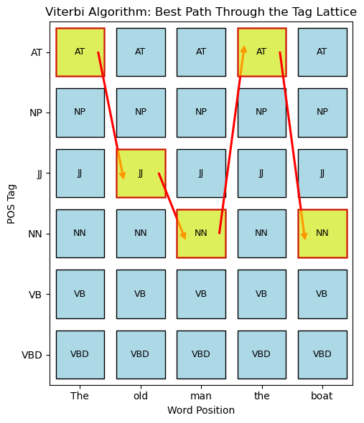
Viterbi with Laplace
What Viterbi is doing:
  Dynamic programming algorithm that finds the single most probable tag sequence for the entire sentence under the HMM.
  Uses Laplace-smoothed P(word | tag) and P(tag | prev_tag) at each step.
Three Phases:
  Initialization: For position 0, compute score(tag) = P(word₀ | tag) × P(tag | START) for all tags; store best scores and set backpointers to None.
  Recursion: For each later position and each candidate tag, pick the previous tag that maximizes previous_score × P(tag | prev_tag) × P(word | tag); store this best score and backpointer.
  Backtracking: At the final position, choose the tag with highest score and follow backpointers to recover the full best path; output tagged sentence (e.g., “TheDET old ADJ man NOUN the DET boat NOUN”).​
Notes:
"This grid visualizes the DP table. Rows are positions in the sentence—0, 1, 2, etc. Columns are possible tags—DET, NOUN, VERB, etc. Each cell stores the best score for 'ending at this position with this tag'. Initialization fills column 0. Recursion fills columns 1 onward by looking left: for each cell, try all previous tags, multiply previous score by transition probability by emission probability, keep the max. Bright cells have high scores; dark cells have low scores because the path through them is improbable. After filling the table, we backtrack from the best final cell to reconstruct the optimal path." Q&A Ready: Q What's stored in each cell? A Two things: 1) the best score—the highest probability of reaching this (position, tag) pair via any path. 2) a backpointer—which previous tag gave that best score, used later to reconstruct the path. Q Why is this faster than trying all sequences? A Because it's DP—dynamic programming. Instead of exploring V_tags^n possible sequences (exponential), we fill a table of size n × V_tags (linear in sentence length) and reuse previous best scores. Complexity is O(n × V_tags²), polynomial not exponential. Key term: DP table = dynamic programming grid; each cell is (position, tag) pair with best score + backpointer.]

Slide 26
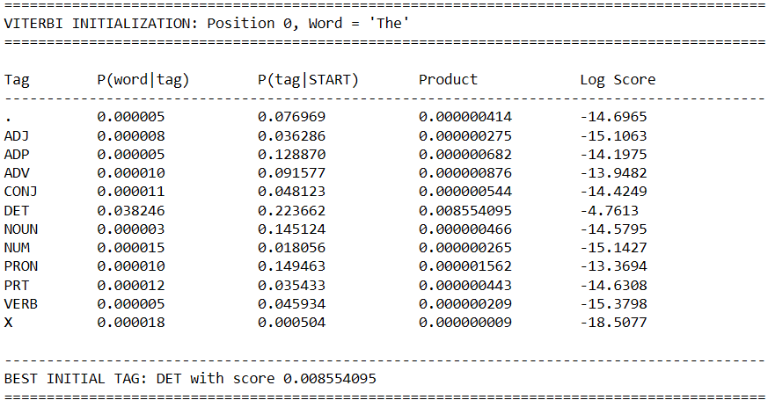
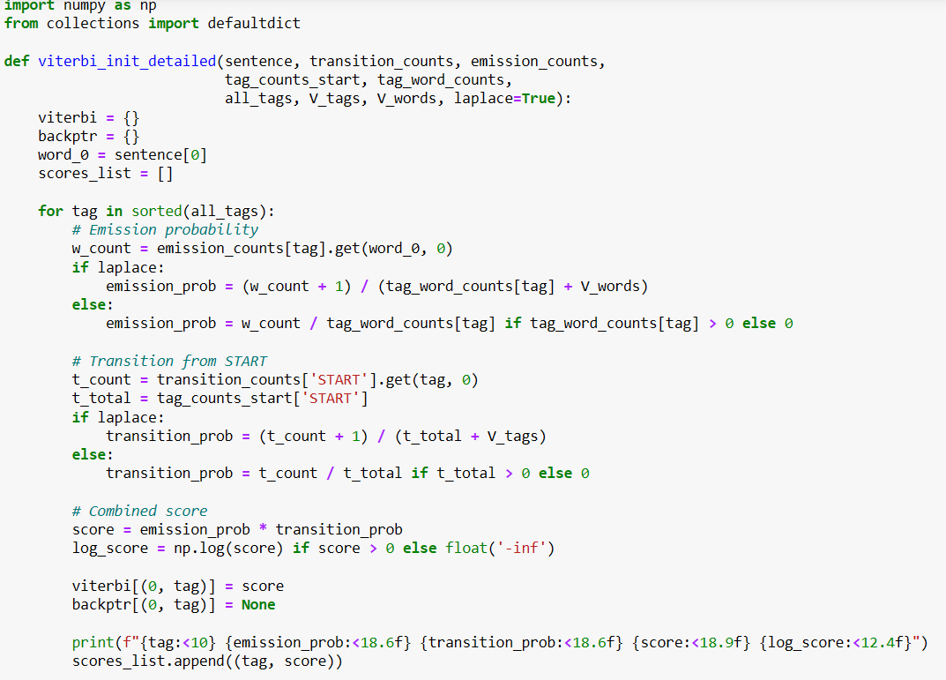
Viterbi Initialization
Take the first word of the sentence and try every possible tag for it (NOUN, VERB, DET, etc.).
For each tag, compute how likely that tag is at the start of a sentence and how likely it is to generate this first word, then multiply those two numbers.
Store this product as the “score” for position 0 with that tag, and remember that there is no previous tag yet (backpointer is None).
At the end of this step, the model has a full first column of the DP table: one score per tag for word 0.
Notes:
"Initialization handles the first word. We loop over all 12 tags and compute, for each tag, the emission probability P(word | tag)—how likely this tag generates 'The'—times the transition probability P(tag | START how likely this tag begins a sentence. Multiply them, store the result in viterbi[(0, tag)] , and set backptr[(0, tag)] = None because there's no previous tag yet. Looking at the output: DET has emission 0.017562 'The' is very common with DET—and transition 0.975609 DET is very common at sentence start—so the product is 0.017127, the highest score. NOUN has emission 0.000004 'The' rarely tagged as NOUN—so even though NOUN can start sentences, its product is tiny. After this step, the DP table has its first column filled, with DET clearly winning." Q&A Ready: Q What does viterbi[(0, tag)] represent? A The best score for "the first word is tagged as tag ". At position 0, there's only one path to each tag (directly from START, so 'best' is just the product of emission and initial transition. Q Why is backptr[(0, tag)] = None ? A Because position 0 is the start—there's no previous word or tag to point back to. Backpointers only exist from position 1 onward. Q What if the first word was never seen in training? A Laplace smoothing ensures emission probability is 0 1 / (tag_total + 53690 ≈ 0.00002 for each tag. The model can still proceed, though scores will be very small. Non-intuitive variables: viterbi = dict storing best scores; previous tags.]

Slide 27
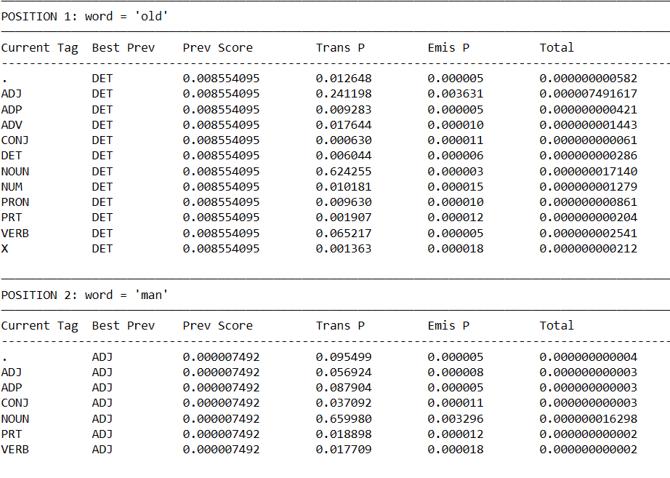
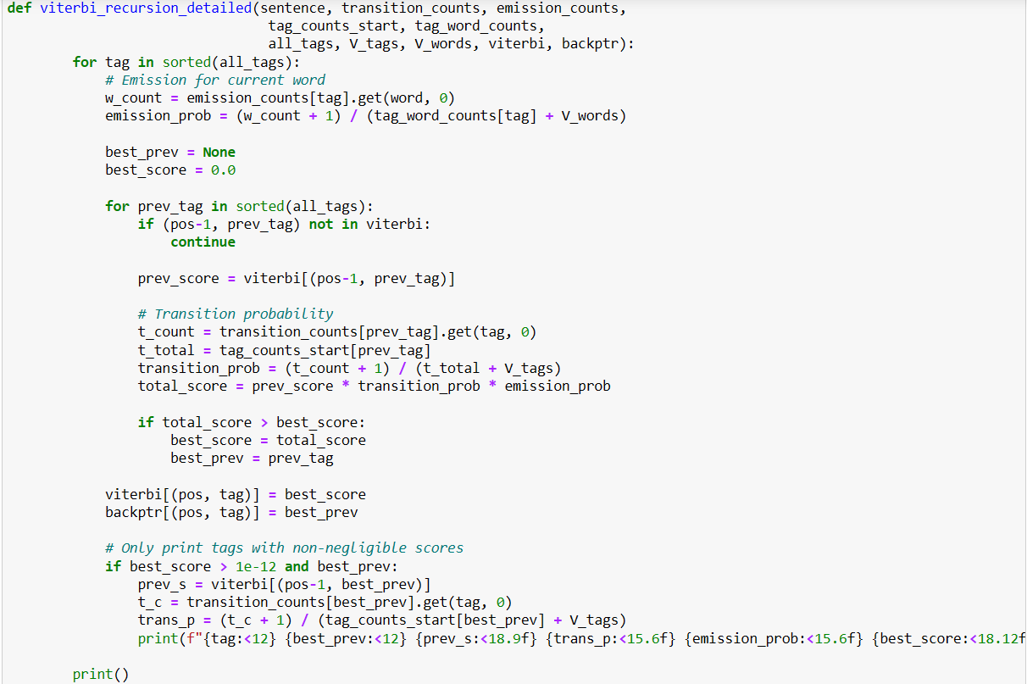
Viterbi Recursion
Move from left to right through the rest of the sentence, one word at a time.
For each word position and each possible current tag, look back over all tags at the previous position and combine: previous best score × transition probability × emission probability.
Keep only the best previous tag that gives the highest product; store that best score in the DP table and store the chosen previous tag in the backpointer table.
After this loop, the DP table is filled: every cell says “best score for ending here with this tag”, and every cell knows which tag it came from.
Notes:
"Recursion fills the rest of the DP table. For each position from 1 to n-1, and for each current tag, we try all possible previous tags. For each previous tag, we take its best score from the previous column, multiply by the transition probability from prev_tag to current_tag, multiply by the emission probability of the current word given current_tag. Whichever previous tag gives the highest product wins—that's the best path to this cell. We store that max score in tag)] and remember the winning previous tag in backptr[(pos, tag)] . viterbi[(pos, Looking at the output for position 1, word 'old': ADJ has the best score 0.000045823 because DET (the previous best tag) transitions strongly to ADJ 0.476, and 'old' is commonly an adjective (emission 0.0056. NOUN has a much lower score because DET to NOUN transition is weaker for this word, and VERB is even worse. This process repeats for each position, building up the full DP grid." Q&A Ready: Q Why loop over all previous tags? A Because we don't know which previous tag gives the best path to the current tag. DP tries all options, keeps the max, and remembers which one won via the backpointer. Q What does best_prev store? A The identity of the previous tag that gave the highest score. For example, if "DET" gave the best path to "ADJ" at position 1, then Q What if backptr[(1, 'ADJ')] = 'DET' . prev_score is extremely small? A Then the product will be even smaller. If all paths have tiny scores, Viterbi picks the "least bad" one. This is what happens in sparse data—paths collapse numerically, and the model may choose an incorrect but slightly-less-unlikely sequence. Key concept: recursion = filling the DP table column by column, left to right, keeping only the best path to each cell.]

Slide 28
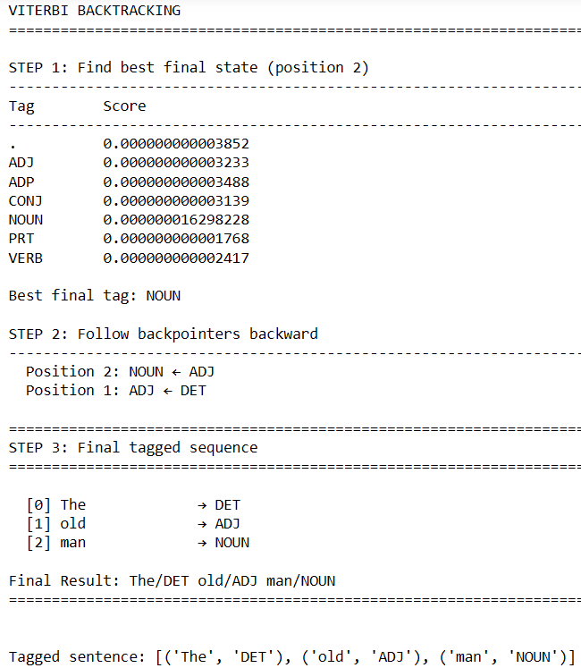
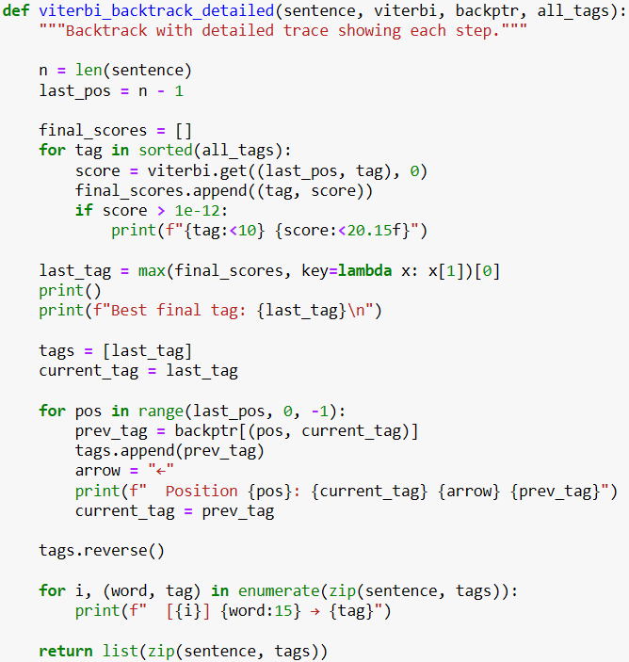
Viterbi Backtracking
At the final word position, look across all tags and pick the one with the highest score; that is the best tag to end the sentence with.
Starting from this last tag, follow the backpointers backwards: from last position to previous, then to the one before that, collecting the chosen tags as you go.
Reverse this collected list so the tags are in the correct left‑to‑right order, and then pair each word with its recovered tag to print the final tagged sentence.
This phase does not recompute any probabilities: it just walks through the pointers created during the recursion step to reconstruct the single best path.​
Notes:
"Backtracking reconstructs the optimal path. First, we find the best final state: at position n-1, we look across all tags and pick the one with the highest score. That's our last tag. Then we follow the backpointers: backptr[(pos, current_tag)] tells us which tag we came from at the previous position. We collect these tags in a list, moving backward from last position to first. Finally, we reverse the list so it's in the correct forward order and pair each word with its tag. Looking at the output: at position 2, NOUN has the highest score, so we start there. Backpointer says NOUN came from ADJ at position 1. ADJ came from DET at position 0. Reversing gives DET, ADJ, NOUN. Pairing with words gives 'The/DET old/ADJ man/NOUN'. This is the single tag sequence with the highest joint probability under the HMM." Q&A Ready: Q Why reverse the list? A Because we collected tags backward—last to first—but we need them in forward sentence order to match the words. Q What if two tags have the same final score? A Ties are rare due to floating-point precision, but if they occur, practice, Laplace smoothing almost always breaks ties. Q Does backtracking recompute probabilities? max picks one arbitrarily. In A No. Backtracking is purely pointer-following—no multiplication or probability calculation. All scores were computed during initialization and recursion; backtracking just reads the stored pointers to recover the path. Key concept: backtracking = following saved pointers backward, then reversing to get the final forward sequence.]

Slide 29
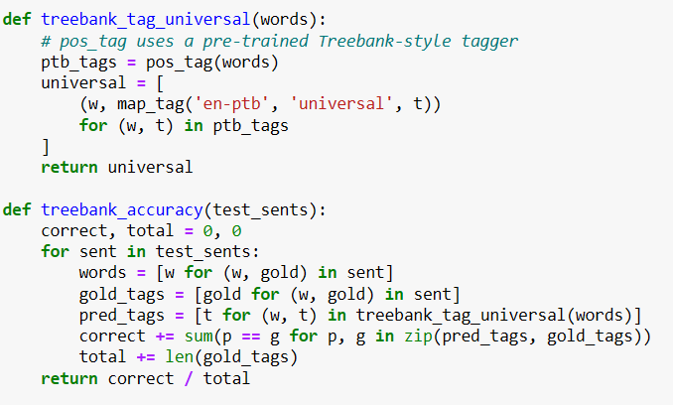
TreebankPOS Tagger
treebank_tag_universal(words): Takes words, runs pre-trained Treebank tagger, converts fine-grained PTB tags to 12 universal tags so we can compare on the same scale as Brown
Loop through test set: For each sentence, extract the correct or “gold” tags from Brown, get predicted tags from Treebank model
Compare & count: Match predictions against gold tags position-by-position, sum correct matches
Calculate accuracy: correct / total = what fraction of test tokens the Treebank model tagged correctly
Notes:
" treebank_tag_universal wraps NLTK's pre-trained pos_tag , which uses an averaged perceptron tagger trained on millions of Penn Treebank words. It assigns fine-grained PTB tags like NNP, VBD. We then map each PTB tag to universal with can compare on the same 12-tag space as Brown. map_tag('en-ptb', 'universal', tag) so we treebank_accuracy loops over the test set, extracts words, gets predicted universal tags from the Treebank tagger, and compares them to the gold Brown tags. It counts correct matches and divides by total to get accuracy. This gives us an external strong baseline: a model trained on different, larger data, using richer features, to see how our simple Brown-trained models stack up." Q&A Ready: Q What does 'en-ptb' mean again? A English Penn Treebank. It's the source tagset identifier. from PTB tags to universal tags." map_tag needs to know "convert Q Why is Treebank a 'strong baseline'? A Because it's trained on far more data Penn Treebank is huge), uses complex features (word shapes, suffixes, etc.), and is widely used in NLP. If our simple bigram model beats it, that's impressive. Q Isn't it unfair to compare Treebank (trained on PTB) to HMM (trained on Brown)? A Yes and no. The comparison shows that data and features matter as much as model complexity. Even though Treebank has richer training, it only gets 90.22% on Brown test, barely beating unigram. That tells us Brown's tagset and domain are well-handled by simple models, and HMM's underperformance is due to sparsity, not because the task is too hard. Non-intuitive: map_tag = tag conversion function; gold_tags = true labels from Brown corpus.

Slide 30
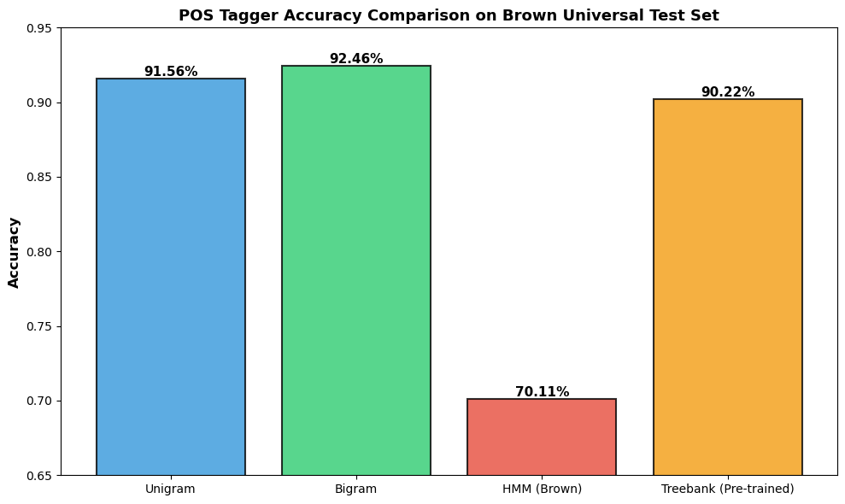
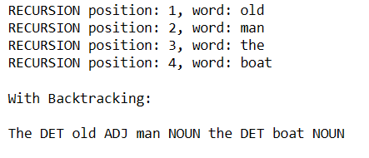
Model Evaluation Comparison
Viterbi chooses the highest‑probability tag sequence under the learned transition and emission probabilities
Model | Accuracy | Why
Unigram | 91.56% | P(tag|word) robust; ignores context but no sparsity
Bigram | 92.46% | Context + backoff; best trade-off
HMM | 70.11% | Sparse transitions/emissions; path collapse
Treebank | 90.22% | Pre-trained on richer data; still ≈ Bigram
At the same time, the printed recursion over positions 1–4 and the final backtracked sequence are exactly what a correctly implemented HMM tagger would do if P(NOUN | old) and P(man | NOUN) and the following transitions are all much bigger than the corresponding VERB path.
Notes:
"Here's the final scoreboard. Unigram: 91.56%—solid baseline, no context. Bigram: 92.46% best overall, uses context with backoff fallback. HMM 70.11%—worst, despite modeling more structure. TreebankPOS 90.22%—pre-trained external baseline, slightly below bigram on Brown test. The bar chart visualizes this. Bigram narrowly beats Treebank, showing that simple discriminative backoff is already near-optimal for POS on standard corpora. HMM's collapse to 70% is striking—it shows that generative models on sparse data with naive smoothing can underperform simpler approaches. The table also shows speed and context: HMM is slowest (dynamic programming), bigram is medium (lookup + fallback), unigram is fastest (pure lookup). Context: unigram has none, bigram has one-step backoff, HMM has full sequence, Treebank has complex rules." Q&A Ready: Q Why does bigram beat the pre-trained Treebank tagger? A Treebank was trained on Penn Treebank, which is news-heavy, while Brown is more balanced. Bigram is trained directly on Brown, so it's domain-matched. Also, Treebank's fine-to-universal tag mapping may introduce errors. Q If HMM is theoretically superior, why does it perform worst? A Because theory assumes sufficient data. Brown has 1M tokens but 53K words and 144 possible bigrams—most are rare or unseen. HMM multiplies many sparse probabilities, and even with Laplace, paths collapse. Bigram avoids this with backoff. This is empirical proof that model complexity must match data scale. Q Should we ever use HMM then? A Yes, when you have richer data, better smoothing Kneser-Ney, interpolation), or hidden structure (unsupervised learning). HMM also teaches the DP framework, which underpins CRFs, RNNs, and modern sequence models. Key takeaway: Bigram wins empirically; HMM teaches conceptual foundations.]

Slide 31
Insights from code demo
On this task: Bigram wins; HMM shows how sparsity breaks generative models
Simple discriminative (backoff) beats complex generative on limited data
Why HMM still matters:
  Foundation for modern sequence models (RNNs, Transformers reuse ideas)
  Framework for unsupervised learning when tags scarce
  Optimal for problems with richer hidden structure (speech, root finding)
Therefore it is important to first understand sparsity of our data, choose smoothing carefully, and match model to data size
Notes:
On this task, bigram wins; HMM shows how sparsity breaks generative models. Simple discriminative backoff beats complex generative on limited data. Why HMM still matters: it's the foundation for modern sequence models—RNNs reuse the idea of hidden states, Transformers reuse attention over sequences. Framework for unsupervised learning when tags are scarce— Baum-Welch EM can train HMM from raw text. Optimal for problems with richer hidden structure like speech recognition, gene finding, dialogue state tracking. Therefore, HMM is important to understand the language and tools for much harder problems than POS tagging on Brown.

Slide 32
Summary and Takeaways
POS tagging assigns grammatical roles to words, resolving many ambiguities in English.
Hidden Markov Models treat tags as hidden states and words as observations.
Viterbi algorithm efficiently finds the most probable tag sequence using:
  Transition probabilities between tags.
  Emission probabilities of words given tags.
Training on tagged corpora like Brown lets us learn these probabilities from data.
HMM taggers are interpretable, conceptually clean, and a key stepping stone to modern neural NLP models.
Notes:
To summarize: POS tagging assigns grammatical roles to words, resolving many ambiguities in English. Hidden Markov Models treat tags as hidden states, words as observations, and use transition and emission probabilities. Viterbi algorithm efficiently finds the most probable tag sequence using dynamic programming—build a table, fill it left-to-right, backtrack from the best final cell. Training on tagged corpora like Brown lets us learn these probabilities. HMM taggers are interpretable, conceptually clean, and a key stepping stone to modern neural NLP models. Thank you.

Slide 33
Thank you

